Slide 1
Percentage Increase and Decrease
Miss L
Year 11 Essentials

Slide 2
Learning Intentions
Students will be able to
Find the percentage of a quantity
Express one quantity as a percentage of another
Solve problems relating to percentage increase/decrease and profit/loss
Apply this knowledge to real-life scenarios

Slide 3
24
7
30
Understanding Percentages Further
Date
EQ – How can we apply our knowledge of percentages to different contexts?
What does % increase mean?
Percentage increase means to make a quantity bigger by a given percentage
We use a percentage increase technique to calculate pay increases or to calculate GST inclusive prices.
Goods and services tax (GST) is a broad-based tax of 10% on most goods, services and other items sold or consumed in Australia.
What is GST?

Slide 4
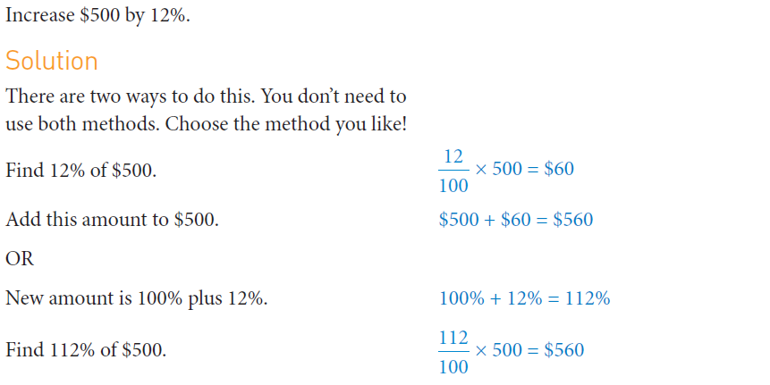

Slide 5
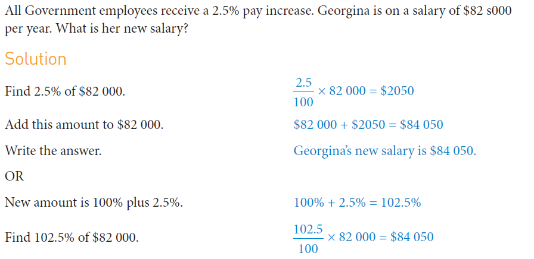

Slide 6


Slide 7
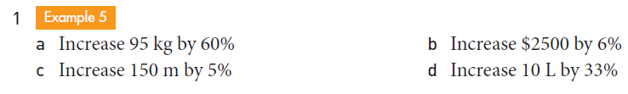
Practice

Slide 8

24
7
30
Understanding Percentages Further
Date
EQ – How can we apply our knowledge of percentages to different contexts?
What does % decrease mean?
Percentage decrease means to make a quantity smaller by a given percentage
We use this technique to calculate discounts and sale prices

Slide 9
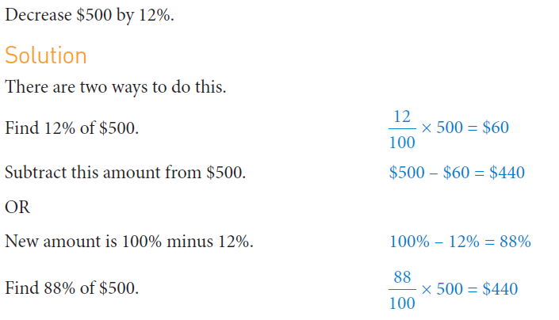

Slide 10
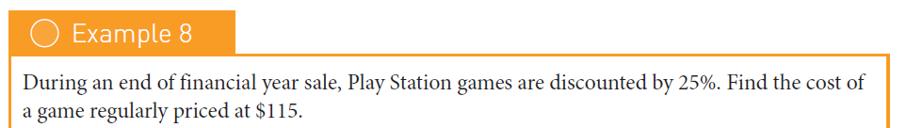
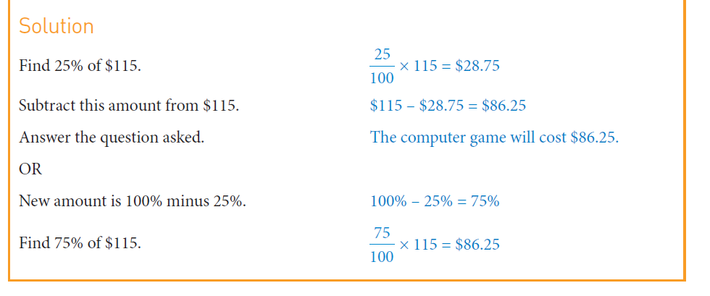

Slide 12
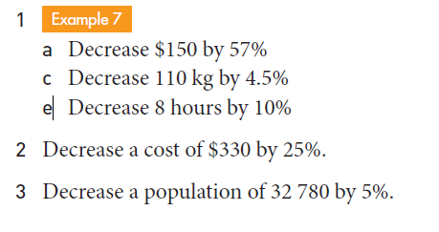
Practice

Slide 13
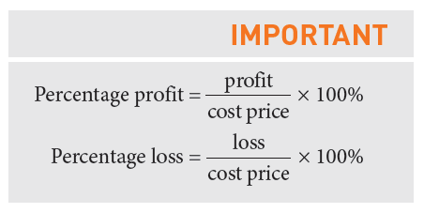
24
7
30
Understanding Percentages Further
Date
EQ – How can we apply our knowledge of percentages to different contexts?
What is Profit and Loss?

Slide 14
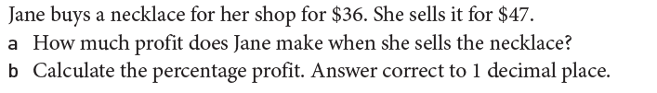
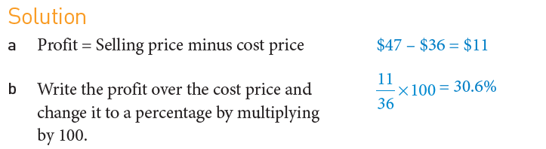

Slide 15
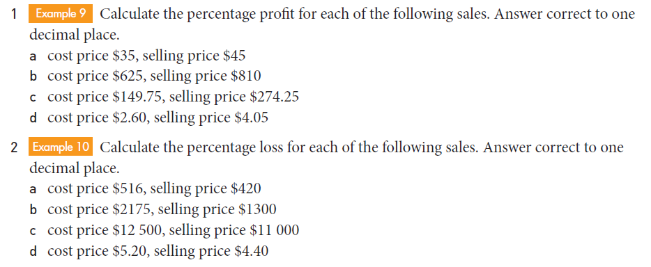
Practice

